Slide 1



CORONAVİRUS Psychosocial Effects of the Epidemic
Data visualization of Examining the relationship between psychosocial and demographic variables with hopelessness and anxiety level during the COVID-19 pandemic process.

Slide 2
INTRODUCTION
After the first coronavirus case was seen in Turkey, people were badly affected in economic, health and psychological and many aspects. The corona epidemic causes psychological and behavioral problems as well as its biological effects. It is not only the virus that is transmitted, but also the extreme phobic reactions caused by social trauma, psychological problems such as depression, panic, paranoia, and destructive behaviors such as selfishness, impulsivity, aggression, stigmatization. In this study, the of examining the relationship between psychosocial and demographic variables and the level of hopelessness and anxiety during the COVID-19 pandemic process data were visualized.

Slide 3
SCOPE & OBJECTIVES
The purpose of this study is to visualize the data of the analysis of anxiety and hopelessness levels according to psychosocial and demographic variables during the COVID-19 pandemic process.

Slide 4
RESULT & GRAPHICS
In this study, it was determined that individuals needed psychological support as well as medical support during the COVID-19 pandemic, which was observed to be characterized by anxiety and hopelessness. In order to solve this problem, it would be beneficial to facilitate their access to mental health support. While putting the measures to reduce virus spread at the center of management strategies, it is necessary to adopt practices that support the physical and psychological health of individuals. Enabling individuals to overcome this process with less physical and psychological damage will result in countries overcoming this process with less economic and social damage in the long term.

Slide 5
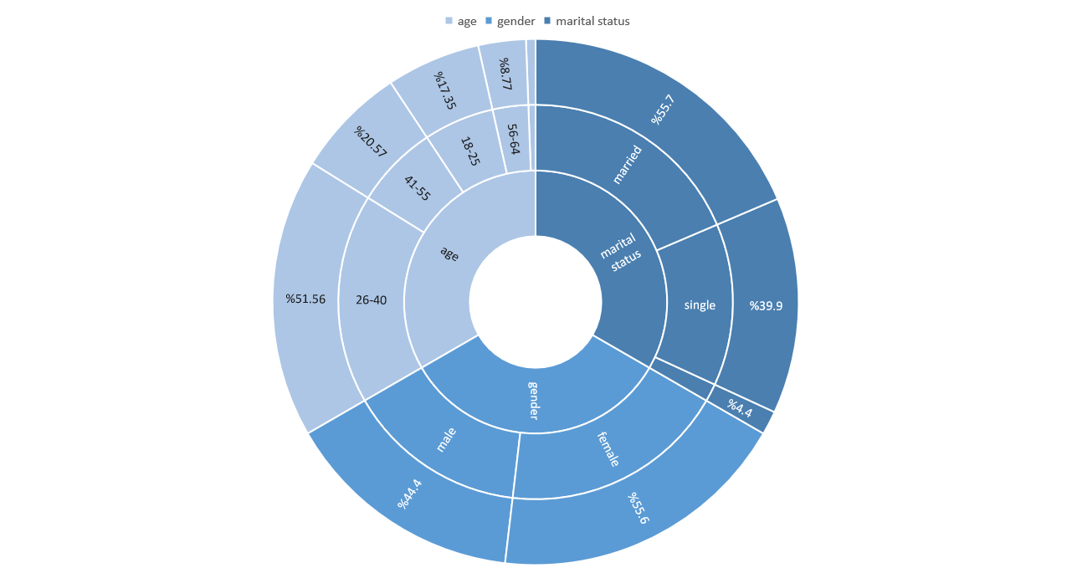
Demographic information of the participants

Slide 6
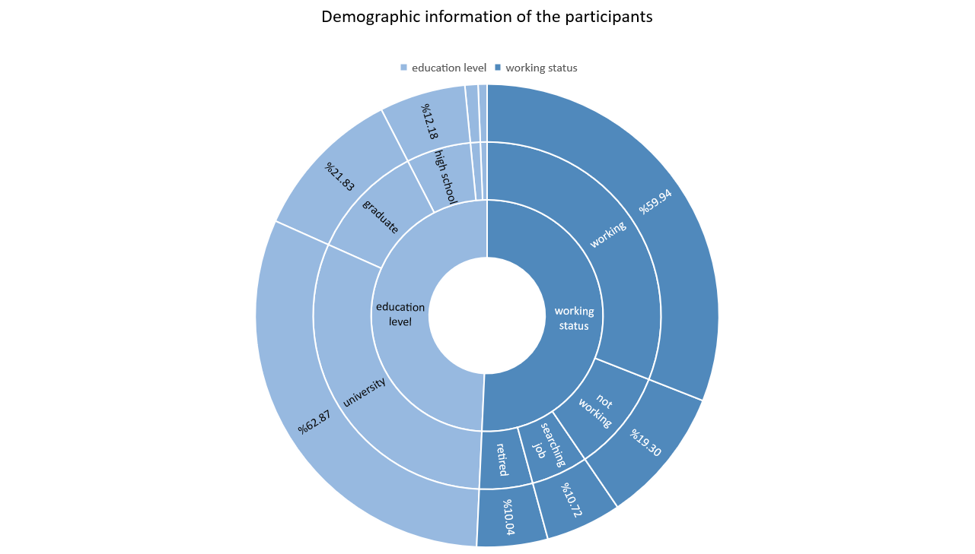

Slide 7
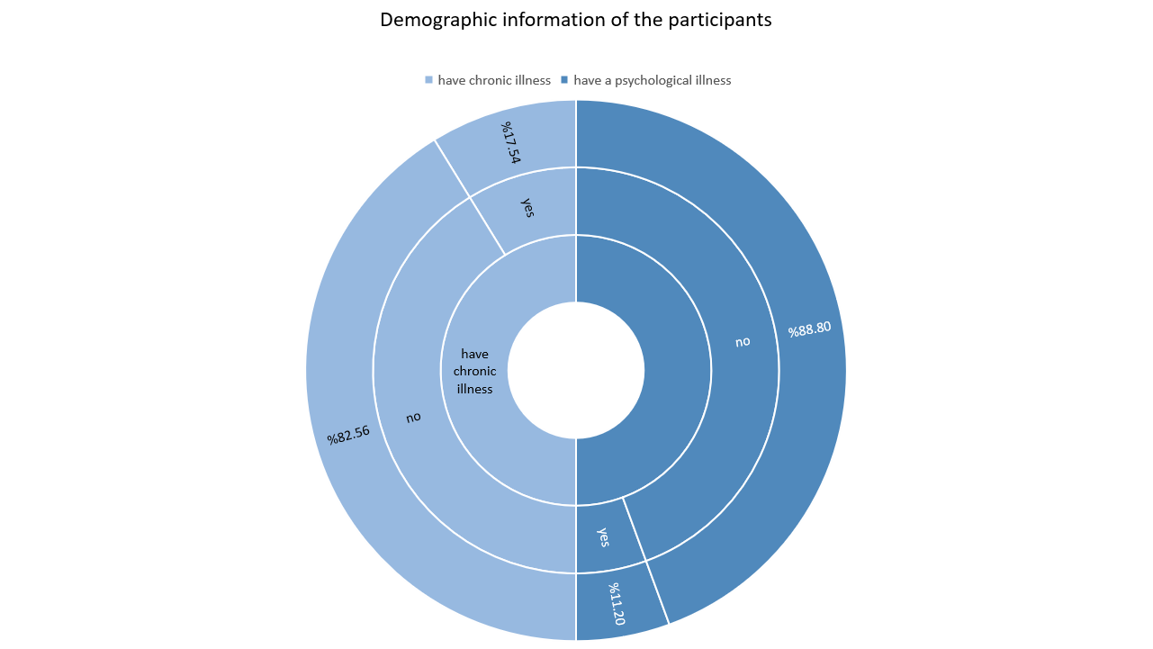

Slide 8
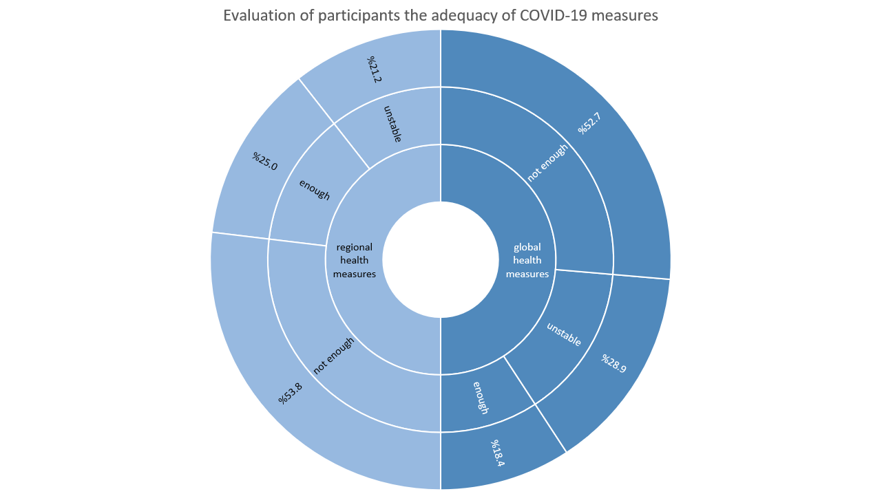

Slide 9
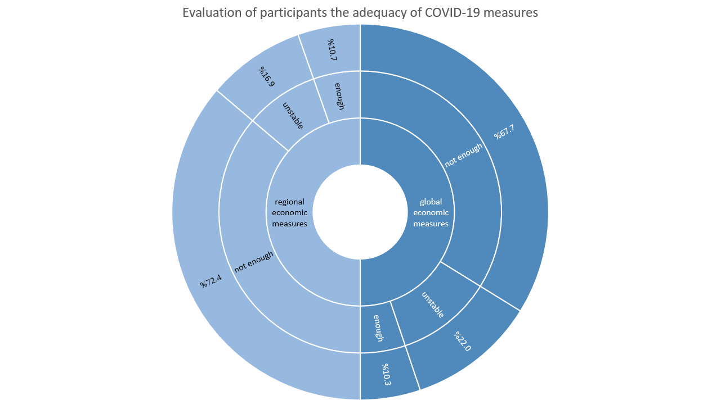

Slide 10


Slide 11
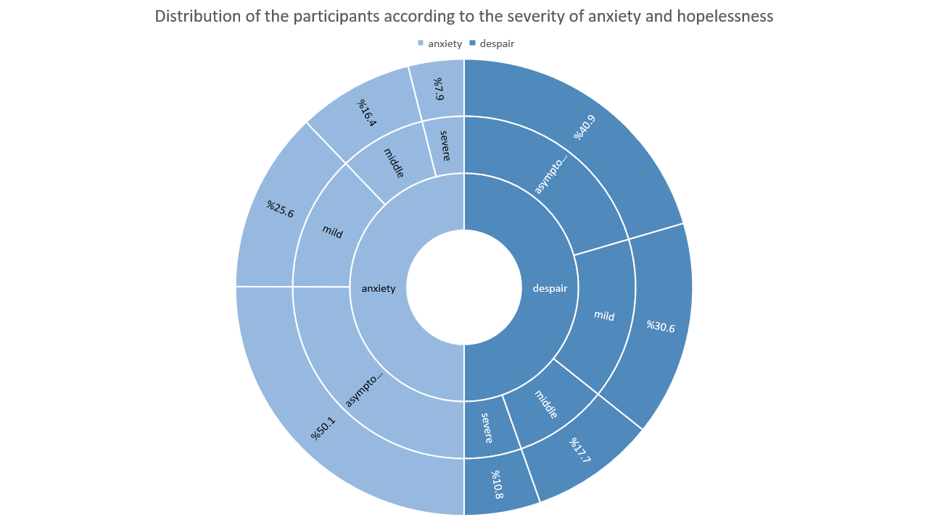

Slide 12
RUMEYSA ÖZER
1703041005

